Slide 1


Jq Command Tutorials
NarendraP
Jq Command for Bash Shell Scripting

Slide 2
Prerequisites for this Course: Jq Command Tutorials
Linux/Mac System to Practice
Knowledge on Command Line
Usage of Pipeline and redirection
Example:
echo “Welcome to JQ Tutorials” | grep “JQ”
grep “JQ” <<< “$(echo “Welcome to JQ Tutorials”)”
Basic Knowledge on JSON Data Structure
Knowledge on any editor like vi/vim/vcode etc…
Basic Knowledge on Bash Shell Scripting
Note: We will use rest api response and AWS CLI Commands Output while doing practice.
Jq is a command-line utility to parse JSON Data

Slide 3
What You Will Learn Here:
Jq command usage to work with JSON Data or Parsing JSON Data With Jq
Usage of Jq command in bash shell scripts
Jq is a command-line utility to parse JSON Data

Slide 4
Basics of Linux Pipes and Redirections
Pipes:
To Pass one command output as an input to another command
Cmd1 | Cmd2
Redirection:
Are used to create a file or to read from a file
Cmd > file.txt to create a new file/re-write new content to an exiting file
Cmd >> file.txt to append content to an existing file
Cmd < input (to provide input as a file)
Cmd << input (to provide input as a multiline )
Cmd <<< input ( to provide input as a string (single or multiple lines))
Cmd <<< “$(command output)”
Jq is a command-line utility to parse JSON Data

Slide 5
Introduction to Jq Command
Jq is a command-line utility to parse JSON Data.
Here, Parse JSON Data is nothing but reading and writing JSON Data with jq
Why We Need to Parse JSON Data:
REST APIs Response
Kubernetes Commands Output
AWS CLI Commands Output
Jq is a command-line utility to parse JSON Data

Slide 6
Installing Jq Command
CentOS/RHEL:
yum update
yum install jq
Ubuntu:
apt-get update
apt-get install jq
Mac:
brew update
brew install jq
Note: We must run all these from root or with root privilege
Jq is a command-line utility to parse JSON Data

Slide 7
Verify Jq Version and help:
jq --version
jq --help
man jq
Jq is a command-line utility to parse JSON Data

Slide 8
Public REST APIs to Practice With Jq
https://apipheny.io/free-api/
Jq is a command-line utility to parse JSON Data

Slide 9
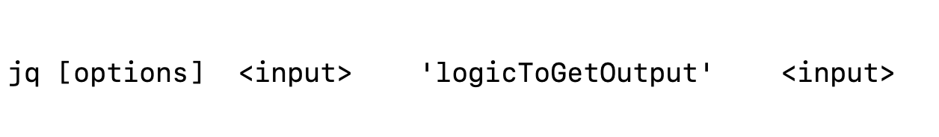
Jq Command Syntax With Input and outputs
NarendraP
Jq Command for Bash Shell Scripting

Slide 10
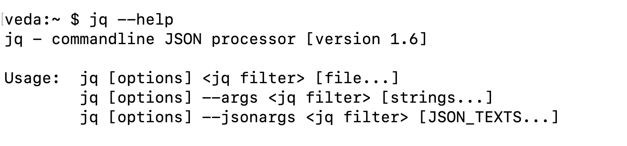
Introduction to Filters
We can read required data from input JSON Data using jq and this process is called filtering the data
We can filter the data using jq filters
Jq is a command-line utility to parse JSON Data

Slide 11
Identity Filter
First Syntax Without Options
Identity Filter:
jq . filename or jq “.” fileName
Input and outputs are identical except format
Jq is a command-line utility to parse JSON Data

Slide 12
Different Ways to Pass JSON Data as an Input to Jq Command:
Passing String
jq . <<< '{"name": "jqCommand"}’
jq . <<< "$(echo '{"name": "jqCommand"}')"
echo '{"name": "jqCommand"}' | jq .
Passing File
cat demo.json | jq .
jq . demo.json
jq . <<< "$(cat demo.json)"
Passing REST API Response
curl -sX GET https://gorest.co.in/public/v2/users | jq .
jq . <<< "$(curl -sX GET https://gorest.co.in/public/v2/users)"
Jq is a command-line utility to parse JSON Data

Slide 13
Field Filter ( Accessing Key Value or Property Value )
We can access Key Value or Property Value using simple filter called field filter
Syntax:
jq .key fileName
jq ‘.key’ fileName
jq “.key” fileName
We can also Chain keys/ properties together to get nested objects.
Syntax:
jq .key1.key2.key3 fileName
Note: Sample REST API: http://stash.compciv.org/congress-twitter/json/joni-ernst.json
Jq is a command-line utility to parse JSON Data

Slide 14
Working With JSON Arrays Using Jq Command
NarendraP
Jq Command for Bash Shell Scripting

Slide 15
Working With JSON Arrays Using Jq Command
Basics of JSON Array:
[ 1,2,4,6,8,9]
{
“technology”: “devops”,
“tools”: [
“Jenkins”,
“bamboo”,
“stackstorm”,
“git”,
“maven”
]
}
Note: JSON Array Values are called items/Elements and these are indexed (+ve and –ve)
Items/Elements are accessed using either +ve/-ve index
Accessing All Array Elements Using Iterator Filter/Array Filter: jq “.[ ]” filename
Accessing Required Array Item: jq ‘.[indexOfTheItem]’ fileName
Jq is a command-line utility to parse JSON Data

Slide 16
Jq option to get raw string
Syntax:
jq -r .key fileName
Jq is a command-line utility to parse JSON Data

Slide 17
Field Filter with Comma and raw string
Syntax:
jq .key fileName
jq .key1,key2 fileName
jq ‘.key1,key2’ fileName
jq -r ‘.key1,key2’ fileName
Jq is a command-line utility to parse JSON Data

Slide 18
Shell Script with jq command :
Requirement: Find File System Usage on Remote Server
Jq is a command-line utility to parse JSON Data

Slide 19
JSON Array Slicing:
Slicing of Array is nothing but getting sub-array from a given array
Syntax:
jq ‘.[startIndex:endIndex]’ filename
jq ‘.[:endIndex]’ filename
Jq. ‘[startIndex:]’ fileName
Jq is a command-line utility to parse JSON Data

Slide 20
Constructing Object |Arrays
jq ‘{}’ <<< ‘{}’
jq ‘{}’ filename
jq ‘{“myKey”: “myValue” }’ <<< ‘{}’
jq ‘{“myKey”: “myValue” }’ filename
jq ‘{“myKey” : .key }’ filename
jq ‘[ ]’ filename
jq ’[ 2,3,4, “value4”]’ filename
jq ‘[ .key ]’ fileName
Jq is a command-line utility to parse JSON Data

Slide 21
Constructing null, number, string and boolean data's
Syntax:
jq -n ‘’ --> null
jq ‘null’ inputFile --> null
jq -n ’4’ --> number
jq -n ‘”jq”’ --> string
jq ‘filter/function’ inputFile --> string
jq -n ‘true/false’ --> boolean
Jq is a command-line utility to parse JSON Data

Slide 22
--tab and -c options
NarendraP
Jq Command for Bash Shell Scripting

Slide 23
JSON Functions:
Jq has many powerful built-in functions
They are:
keys → To get keys for a json object
length → To find the number of keys for an object or length of an array
or even length of a value
min/max → To find min or max value from an array
reverse → it reverse an array
sort → To sort the values in an array
unique → It removes duplicate values from an array and data is sorted
del → It deletes key value pair from json object
Note: only in output not in input json
Note: Functions are case-sensitive and Don’t Apply . before any function
Jq is a command-line utility to parse JSON Data

Slide 24
Pipe Usage in Jq Command:
Pipes are used to chain commands in Linux/Unix/Mac, Same way we can use Pipe to combine filters and functions.
Example:
jq ‘.key’ filename | jq ‘length’
jq ‘.key | length’ fileName
Jq is a command-line utility to parse JSON Data

Slide 25
join and range Functions:
The function ‘join’ is used to join array items with a given string
Syntax:
jq ‘join(“string”)’ inputArray
The range function is used to generate an array of numbers
Syntax:
jq ‘range(from;upto;step)’ emptyInput
Jq is a command-line utility to parse JSON Data

Slide 26
has Function:
The ‘has’ function returns true/false based on whether the input object has a given key or input array has element at given index
Note: has function output is either true or false
Syntax:
jq ‘has(“key”)’ filename (if input is json object)
jq ‘has(indexPosition)’ filename (if input is json array
Jq is a command-line utility to parse JSON Data

Slide 27
map Function:
map function is used to translate all items in an array to new array items
Note: Input and Output both are always arrays
Syntax:
jq ‘map(filter)’ filename
jq ‘map(function)’ filename
jq ‘map(filter) | filter’ filename
jq ‘map(function)| filter’ filename
jq ‘map(filter) | function’ filename
jq ‘map(function) | function’ filename
Jq is a command-line utility to parse JSON Data

Slide 28
select Function:
The select function is used to select elements based on given test condition.
Note: testConditon can be formed using comparison operators, logical operators, has function, contains function or any other but result would be always either true or false
Syntax:
jq ‘select(testCondition)’ filename (Note: data should be an object)
jq ‘.[ ]| select(testCondition)’ fileName. (Note: data should be an array)
jq ‘map(select(testCondition)’ )’ filename (Note: data should be an array)
testConditions:
Comparison Operators: ==, <, <=, >,>= , !=
Logical Operatos : and ,or, not
has(key)
.key | contains(“string”)
Jq is a command-line utility to parse JSON Data

Slide 29
env Object:
The env Object is the default object in jq
The env Object is used to access OS Environment Variables or Custom Variables in jq
How to access OS Env variables:
Syntax:
jq -n ‘env.USER’
jq -n ‘$ENV.USER’
jq ‘{“currentUser”: env.USER }’ inputFilename
jq -n ‘{“currentUser”: env.USER}’
jq -n ‘{“currentUser”: $ENV.USER}’
How to Access custom variables ?
Syntax:
myVar=Value jq -n ‘{ “myKey”: env.myVar}’
or
export $myVar=value
jq -n ‘{ “myKey”: env.myVar}’
Jq is a command-line utility to parse JSON Data

Slide 30
--arg Option
The --arg option is used to access OS Environment Variables or Custom Variables in jq
Syntax:
jq -n --arg key “value” ‘{“key” : $key }’
jq -n --arg key “$(date)” ‘{“date”: $key }’
jq -n --arg key “${USER}” ‘{“USER”: $key}’
jq -n --arg key1 “value1” --arg key2 “value2”. ‘{“first”: $key1, “second”: $kye2 }’
Jq is a command-line utility to parse JSON Data

Slide 31
--arg option to work variables (Env & Custom)
NarendraP
Jq Command for Bash Shell Scripting

Slide 32
Functions : tonumbr, tostring, ascii_upcase and ascii_downcase
NarendraP
Jq Command for Bash Shell Scripting

Slide 33
Inputs to Work With Filters/Functions/Conditional Statements:
Usage of Inputs in Filters:
Input with arg option: [$Input]
Input with env object: [env.Input]
Usage of Inputs other than Filters:
Input with arg option: $Input
Input with env object: env.Input
Jq is a command-line utility to parse JSON Data

Slide 34
Conditional Statements
NarendraP
Jq Command for Bash Shell Scripting

Slide 35
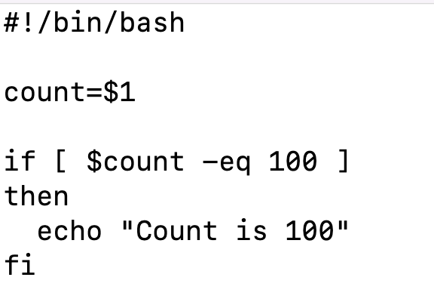
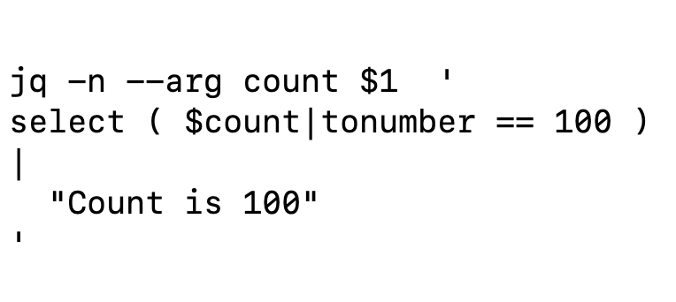
Conditional Statements:
Simple If Condition:
Jq is a command-line utility to parse JSON Data

Slide 36
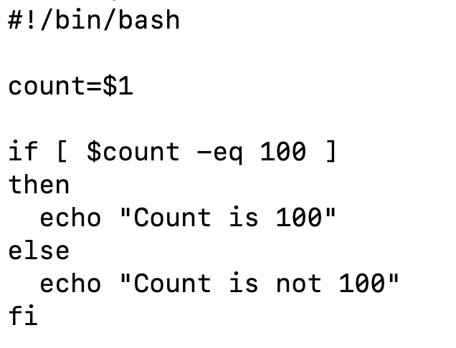
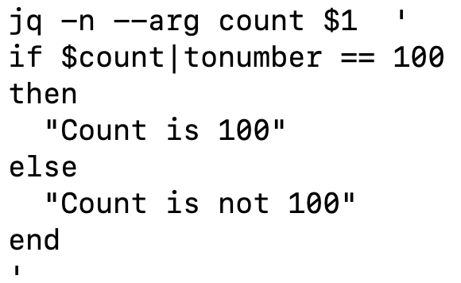
Conditional Statements:
If else Condition:
Jq is a command-line utility to parse JSON Data

Slide 37
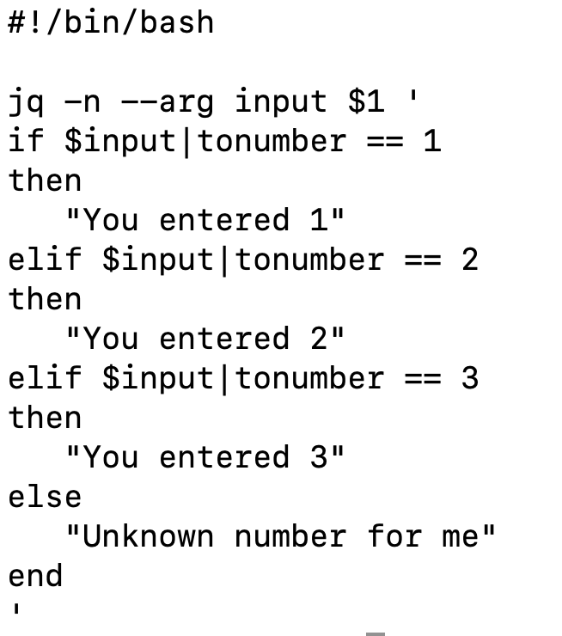
Conditional Statements:
If elif ….else:
Jq is a command-line utility to parse JSON Data

Slide 38
Jq Command With Exit Status Using -e Option
NarendraP
Jq Command for Bash Shell Scripting

Slide 39
Concatenation of Strings Using Jq Command
NarendraP
Jq Command for Bash Shell Scripting

Slide 40
Encode & Decode a String Using Jq Command
NarendraP
Jq Command for Bash Shell Scripting

Slide 41
Arithmetic Operators Using Jq Command
NarendraP
Jq Command for Bash Shell Scripting

Slide 42
Creating Bash Array from JSON Arrays Using Jq
NarendraP
Jq Command for Bash Shell Scripting

Slide 43
How to Use Jq Command for Kubectl ?
NarendraP
Jq Command for Bash Shell Scripting

Slide 44
Thank you

